Slide 1
Writing to Inform
Essential Question: What should informative writing include?

Slide 2
DO THIS:
DON’T DO THIS:
FACT: Dinosaurs roamed the earth many years ago.
OPINION: Dinosaurs are awesome!
FORMAL STYLE: This brochure will tell you all about cancer.
INFORMAL STYLE: Wuzzup peeps! Imma gonna tell y’all ‘bout cancer Yo!

Slide 3
DO THIS:
DON’T DO THIS:
STRAIGHTFORWARD:
Cancer kills many people each year.
NOT STRAIGHTFORWARD: You may have heard some place about this thing called cancer. It has been known to maybe kill people each year.

Slide 4
DO THIS:
DON’T DO THIS:
PRESENT TENSE: Cancer kills!
NOT PRESENT TENSE: Cancer killed!
ADDRESSING THE READER: Everything someone might need to know.
ADDRESSING THE READER: Everything you need to know.

Slide 5
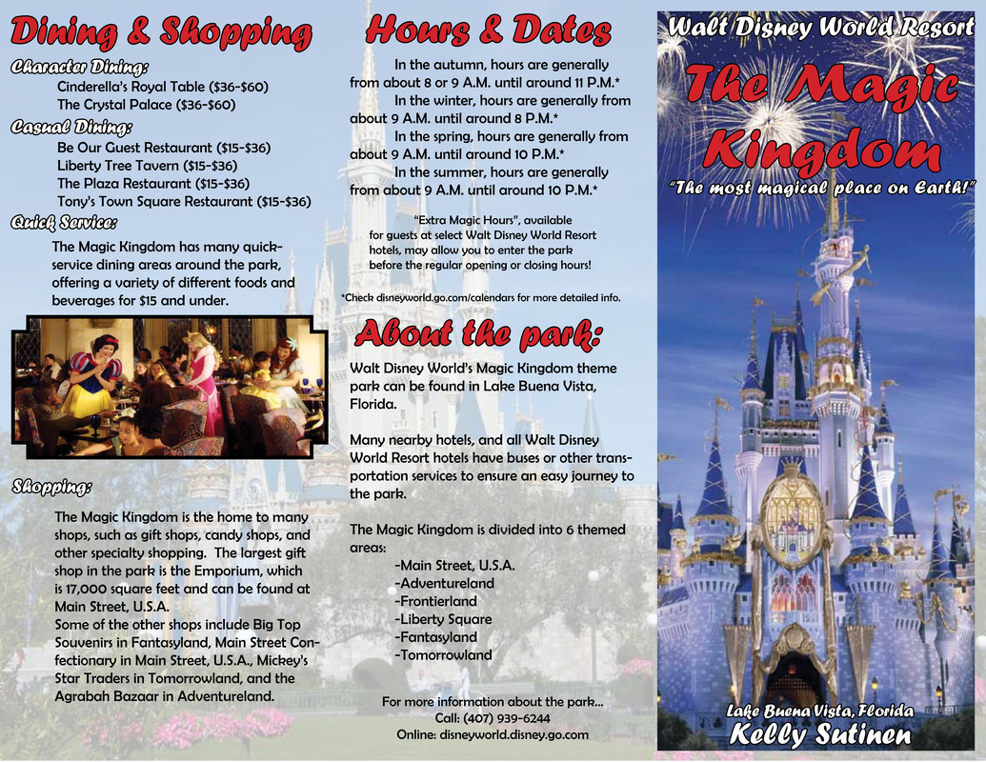

Slide 6
